Slide 1
Microcontroller programming
Fuszenecker Róbert
2011.

Slide 2

Embedded systems
An embedded system is a
computer system
designed to perform one or few dedicated functions
often with real-time computing constraints.
Definition: from Wikipedia.

Slide 3
Embedded systems
Typical types of embedded systems:
Industrial computer,
System on module, computer on module,
Microcontroller,
FPGA.

Slide 4
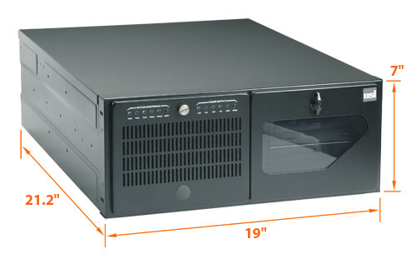
Industrial computers

Slide 5
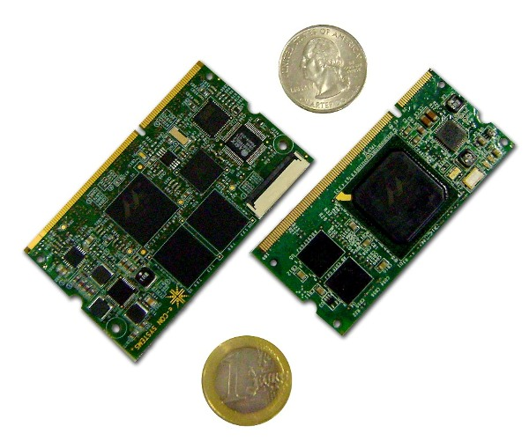
System on modules

Slide 6
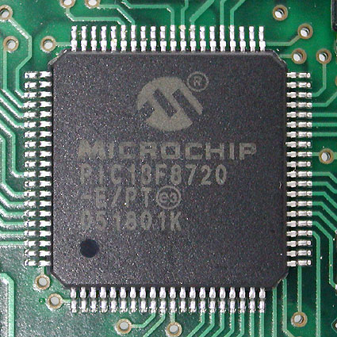
Microcontrollers

Slide 7
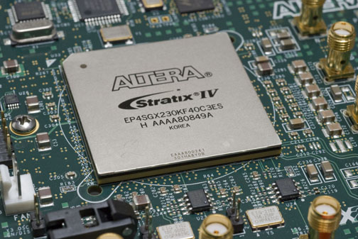
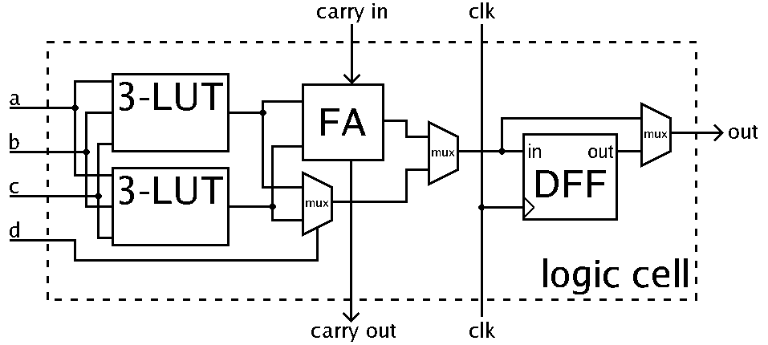
FPGAs
FPGA: Field Programmable Gate Array

Slide 8
Embedded operating systems
Industrial computers and system-on-modules are based on 32-bit processors (with MMU) and have enough resources to run operating systems, i.e. Linux or Windows CE.
Microcontrollers sometimes run real-time operating systems: FreeRTOS, QNX Neutrino, etc.
FPGAs generally don't run anything,
in certain cases they realize soft microprocessors that may run Linux: MicroBlaze, NIOS 2.

Slide 9
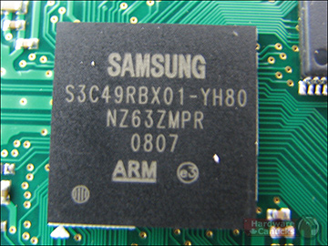
ARM cores
ARM Holdings don't produce any silicon chips, they design only the core of the processors.
ARM: Advanced RISC Machine.

Slide 10
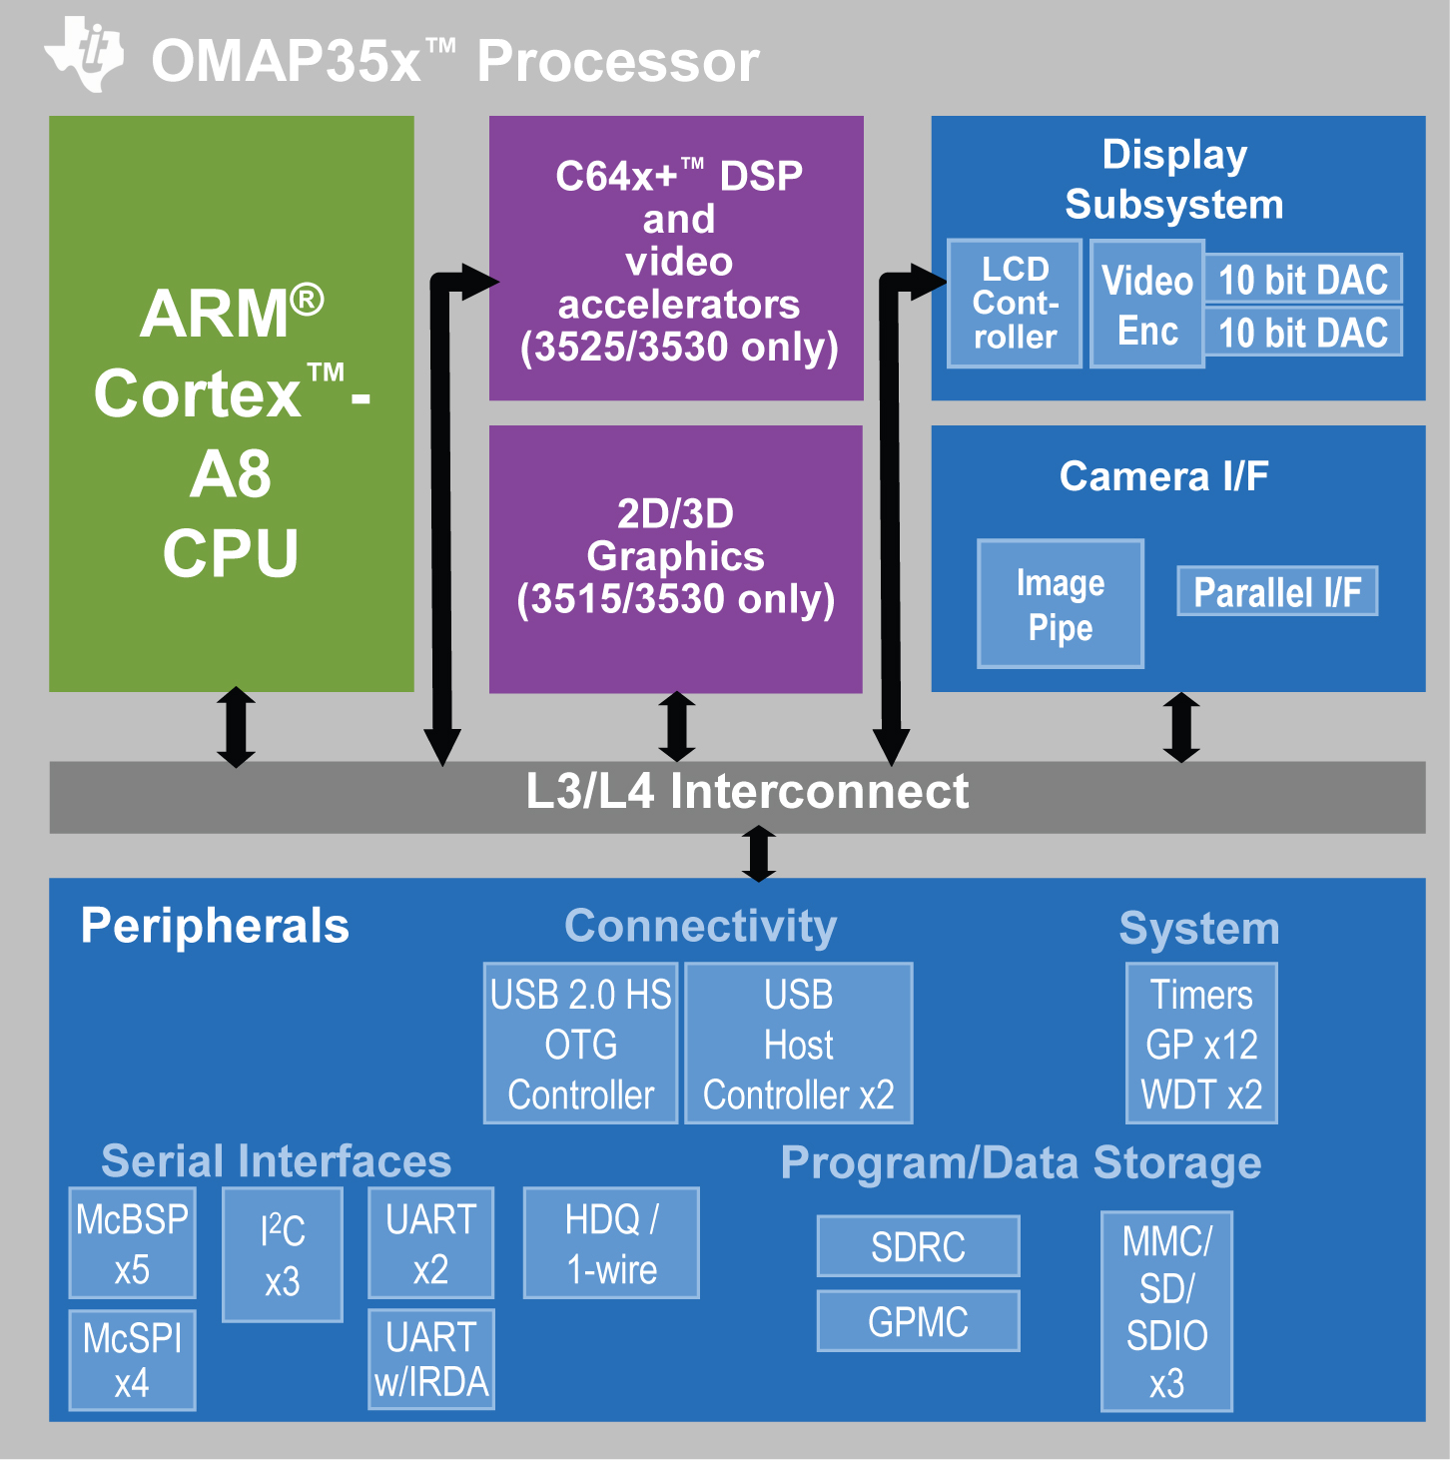
ARM cores

Slide 11

ARM cores
There are 3 kinds of ARM cores:
Application processors (can run Linux).
  Cortex-A8 (single core), Cortex-A9 (dual or quad core),
  Cortex-A15 (quad core, servers),
Microcontroller cores.
  Cortex-M3, Cortex-M1 (low power), Cortex-M0 (FPGA),
Obsolete cores (not recommended for new designs),
  ARM7, ARM9, ARM11.

Slide 12
Processor modes (Cortex-A)
Abort Mode,
Fast Interrupt Mode (FIQ),
Interrupt Request Mode (IRQ),
Supervisor Mode (kernel),
System Mode (similar to User Mode),
Undefined Mode,
User Mode (user space applications),
Monitor Mode (debug).

Slide 13
Processor modes (Cortex-M)
Thread mode (to execute application software),
Handler (interrupt and exception handlers),
Supervisor mode (after RESET).
Generally, “thread mode” is not used in embedded systems.

Slide 14
Register set
ARM processors have 16 × 32 bit registers, many of them has special functions:
R15: instruction pointer,
R14: link register,
R13: stack pointer,
R11: frame pointer (optional).
The other ones are general purpose registers.

Slide 15
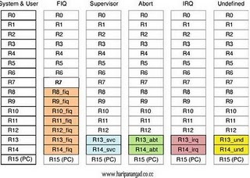
Register set (Cortex-A)

Slide 16
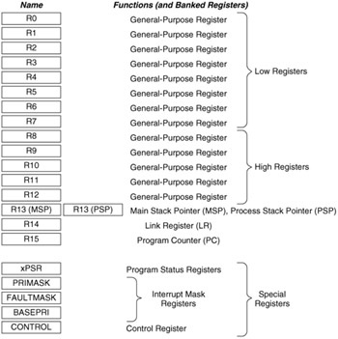
Register set (Cortex-M)

Slide 17
Instruction set
ARM Cortex-A cores support both ARM (32 bit) and THUMB (16 bit) instructions (as well as many floating point, DSP and SIMD instructions).
ARM Cortex-M cores support THUMB2 (16 or 32 bit) instructions only.
THUMB2 instructions are the 16 or 32 bit equivalent of the 32-bit ARM instructions. They are used to save memory in resource-critical applications (μC).

Slide 18
Instruction set
ARM instruction example (always encoded as a 32-bit word):
e08631a7 add r3, r6, r7, lsr #3
THUMB2 instruction examples (16 or 32 bit, depends on the instruction itself):
683a ldr r2, [r7, #10]
fbc3 1204 smlal r1, r2, r3, r4

Slide 19
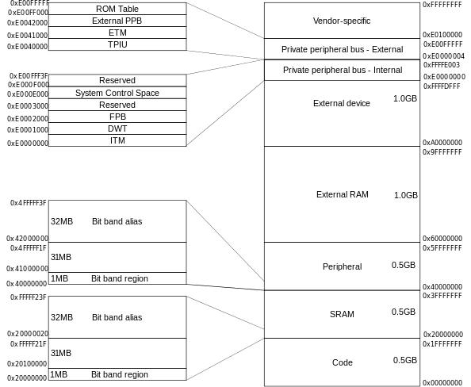
Memory map (Cortex-M)

Slide 20
Interrupt vectors (Cortex-A)
Physical Address | Vector name
0x0000'0000 | Reset
0x0000'0004 | Undefined instruction
0x0000'0008 | Software interrupt
0x0000'000C | Prefetch abort
0x0000'0010 | Data abort
0x0000'0014 | (not used)
0x0000'0018 | IRQ
0x0000'001C | FIQ

Slide 21
Interrupt vectors (Cortex-M)
Physical Address | Vector name
0x0000'0000 | Initial SP
0x0000'0004 | Reset Handler
0x0000'0008 | NMI Handler
0x0000'000C | Hard Fault Handler
0x0000'0010 | Memory Management Handler
0x0000'0014 | Bus Fault Handler
0x0000'0018 | Usage Fault Handler
... | ...
0x0000'0040 | Hardware Interrupt 0
0x0000'0044 | Hardware Interrupt 1
... | ...
0x000'003FC | Hardware Interrupt 243

Slide 22
Booting the processor (Cortex-A)
After the RESET event the Cortex-A* processor starts to execute the instruction that can be found at address 0x0000'0000.
This is typically an unconditional jump to the ROM code that loads the “real” boot loader.
00000000 ldr pc, [pc, #ROM_CODE]
The boot loader should be able to load and start the Linux kernel or anything else.

Slide 23
Booting the processor (Cortex-M)
The 0th element of the vector table is the initial value of the stack pointer: usually the last addressable cell of the internal RAM.
The 1st item is the RESET vector, this is an ADDRESS that points to the “main” function.

Slide 24
Booting the processor (Cortex-M)
__attribute__ ((section(".interrupt_vector")))
void (*const Vectors[])(void) = {
(void *)0x20003FFC // The initial stack pointer
Reset_Handler, // The reset handler
... // Other interrupt handlers
};
extern int main(void);
void Reset_Handler(void) {
While(1) {
main();
}
}

Slide 25
The main() function
Since the stack pointer is set up by the hardware, the processor core is ready to start the “real” task.
Typically the main() function
  sets up the hardware peripherals (by using the Firmware library),
  the interrupt controller,
  optionally the Memory Protection Unit,
  and waits for interrupts (low power mode).

Slide 26
Memory mapped I/O
Several “memory cells” are directly connected to hardware peripherals.
Hardware registers can be accessed by (memory) read and write instructions, similarly to RAM operations.
Hardware registers can be protected by the Memory Management Unit (permission control) or the Memory Protection Unit (MPU).

Slide 27
Accessing HW registers
#define ADC_BASE_ADDRESS 0x4000A000
#define ADC_START_CONVERSION 0x00000004
typedef struct {
uint32_t adc_status;
uint32_t adc_value;
uint32_t adc_error;
} adc_hw_t;
adc_hw_t *adc0 = (adc_hw_t *)ADC_BASE_ADDRESS;
adc0->adc_status |= ADC_START_CONVERSION;
return_value = adc0->adc_value;

Slide 28
Firmware library
The firmware library is provided by the chip manufacturer (hardware-dependent).
Contains high level interface to hardware registers:
  Names instead of addresses (#define),
  Functions to manipulate the HW registers.
Sometimes a digital signal processing library is included, so that the programmer doesn't need to work with assembly instructions.

Slide 29
Firmware library example
int main()
{
SysCtlPeripheralEnable(SYSCTL_PERIPH_GPIOA);
GPIOPadConfigSet(GPIO_PORTA_BASE, GPIO_PIN_3,
GPIO_STRENGTH_8MA, GPIO_PIN_TYPE_OD);
GPIOPinTypeGPIOOutput(GPIO_PORTA_BASE, GPIO_PIN_3);

Slide 30
Firmware library example
SysTickPeriodSet(SYS_TICK_PERIOD);
SysTickIntRegister(systick_handler);
SysTickIntEnable();
SysTickEnable();
IntMasterEnable();
for (c = 0; ; c++) {
counter += c;
asm("wfi");
}
}

Slide 31
Firmware library example
volatile unsigned int pin_data = 0;
volatile int counter;
void systick_handler()
{
pin_data = GPIO_PIN_3 - pin_data;
GPIOPinWrite(GPIO_PORTA_BASE, GPIO_PIN_3, pin_data);
counter++;
}

Slide 32
With “volatile”
for (c = 0;; c++) { R2: counter
counter += c; R3: &counter
104: 681a ldr r2, [r3, #0] R4: c
106: 18a2 adds r2, r4, r2
108: 601a str r2, [r3, #0]
asm("wfi");
10a: bf30 wfi
10c: f104 0401 add.w r4, r4, #1
110: e7f8 b.n 104 <main+0x64>

Slide 33
Without “volatile”
for (c = 0;; c++) {
counter += c;
asm("wfi");
fc: bf30 wfi
fe: e7fd b.n fc <main+0x5c>

Slide 34
Compiling the sources
Commercial compilers:
  ARM RVDS,
  Keil,
  CrossWorks,
  etc.
Open source compilers:
  gcc,
  clang/llvm.

Slide 35
Compiling the sources (gcc)
With cross-compiled gcc:
Compiling the source code:
gcc -march=arm -c -o crt.o crt.c
Linking the objects:
ld -T cm3.ld -o fw crt.o \
main.o fwlib.a
Converting to the appropriate format
objcopy -O binary fw fw.bin

Slide 36
Compiling the sources (LLVM)
With LLVM (not cross-compiled):
Compiling the C source code:
clang -emit-llvm -c main.c
Translating the LLVM object:
llc -march=thumb -mcpu=cortex-m3 \
-o main.s main.ll
Compiling the assembly source:
as -o main.o main.s

Slide 37
Compiling the sources (LLVM)
Linking the object files and the driver library
(the same as the gcc way):
ld -T cm3.ld -o fw crt.o \
main.o fwlib.a
Generating binary output file (FLASH image):
objcopy -O binary fw fw.bin

Slide 38
Behind the scenes: linking
There are sections in the object files, i.e.:
  Code (.code; the instructions to be run)
  Data (.data, .bss; global and static local variables)
  Read-only data (.rodata; const values, initial values of global variables)
  Debug information (.debug_info, .debug_line, ...)
  Interrupt vectors section (.interrupt_vector – defined by us:
__attribute__((section(“.interrupt_vector”)))

Slide 39
Behind the scenes: linking
Sections in executable files:
  Sections of the object files should be merged,
  Sections should be reordered according to the linker script,
  Function calls, variable access should be resolved,
Linker scripts
  Defines the sections (and their order) of the executable files.

Slide 40
Linker scripts
MEMORY
{
FLASH (rx) : ORIGIN = 0x00000000, LENGTH = 0x40000
SRAM (rwx) : ORIGIN = 0x20000000, LENGTH = 0x10000
}

Slide 41
Linker scripts
SECTIONS
{
.text :
{
*(.stack_pointer)
*(.interrupt_vector)
_text = .;
*(.text .text.*)
*(.rodata .rodata*)
_etext = .;
} > FLASH
.bss : AT (_etext)
{
_data = .;
*(.data .data.* .bss .bss.*)
_edata = . ;
} > SRAM

Slide 42
After linking
cortex-m3: file format elf32-littlearm
Sections:
Idx Name Size VMA LMA File off Algn
0 .text 00002674 00000000 00000000 00008000 2**2
CONTENTS, ALLOC, LOAD, READONLY, CODE
1 vtable 0000011c 20000000 00002674 00010000 2**2
CONTENTS, ALLOC, LOAD, DATA
2 .bss 00000008 2000011c 00002790 0001011c 2**2
ALLOC, LOAD, DATA

Slide 43
Debug
We can use a simulator to debug our code:
  gdb's built-in simulator (emulates a processor),
  qemu (emulates a complete device),
Or we can use the target hardware to debug the firmware; we need
  a program to download the FLASH content (firmware),
  a gdb-proxy (which communicates with the hardware),
  the gdb (GNU's debugger; ARM version),
  optionally an IDE.

Slide 44
Debugger operations
Step-by-step C/C++ code analysis
Breakpoints on instructions
Watchpoints on variables
Step-by-step assembly code analysis
Memory and register dump

Slide 45
Programming languages
Can we use programming languages other than C?
Industrial computers and system-on-modules boot Linux or Windows CE, thus the answer is: yes.
C++(0x) code for microcontrollers is not rare, but C# (.NET micro framework) is not really used.
If the FPGA realizes a soft processor, any languages can be used.

Slide 46
Difficulties with C++
No memory management
[operator new() and operator delete() can be implemented],
Exception handling is problematic,
Virtual function calls are difficult to implement,
GNU's libstdc++ is not enough resource-efficient,
  But we can use CLANG's libstdcxx instead of GNU's libstdc++.

Slide 47
Questions?

Slide 48
Thank you for your attention!

Slide 49
References
Cortex™-A8 Technical Reference Manual (Revision: r3p2)
Cortex™-M3 Technical Reference Manual (Revision r2p1)
ARM Architecture Reference Manual ARMv7-A and ARMv7-R Edition
ARMv7-M Architecture Reference Manual

